Slide 1

Turning data into wisdom

Slide 2
The Problem
Municipalities:
Facing issues understand their citizens’ needs, often using their intuition as a base for decisions.
Underutilize their data potential by limiting its application to individual departments.
Respond reactively to issues rather than proactively planning for the future.
Waste substantial funds to redundant projects, and addressing unforeseen issues.
Fail to understand citizens’ needs
Underutilize their data potential
React to issues
Incur substantial expenditures

Slide 3

Market Size
01
Target Market
Mid tier (4-7) Israeli municipalities in digilocal index of Deloitte.
02
16M$
Served Available Market
All Israeli municipalities.
34M$
03
Total Available Market
Europe and Northern America (USA, Canada) municipalities..
28B$
Notes:
Our target market is based on digilocal index of Deloitte, this index shows which municipalities in Israel adopt digital services to their citizens.
We plan to go on mid tier, because we believe they are more likely than low tier and high tier to use our product.
Then we plan to reach all Israeli municipalities and afterward we plan to expand to other western countries.

Slide 4
The Solution
Design customized, innovative data solution tailored for municipalities.
Our goal is to shift municipalities from traditional structures to Data-driven organizations.
Aggregating data from various department into a centralized municipality repository.
Create a user friendly platform with dashboards, analysis and reporting tools, machine learning models and advanced language models such as GPT-4.
The platform will optimize municipalities decision making process and suggest areas of focus for future projects.
Notes:
In MuniMatrix we believe that data is a power that can be harnessed.
Municipalities generate a lot of data in various departments but they are traditional and rarely use it’s full potential.
Solving issues when they occur cost more than plan ahead proactively.
If municipalities understood citizens needs, they were empowered to proactively plan, anticipate, and comprehend future challenges, they could address and resolve issues before they even manifest

Slide 5


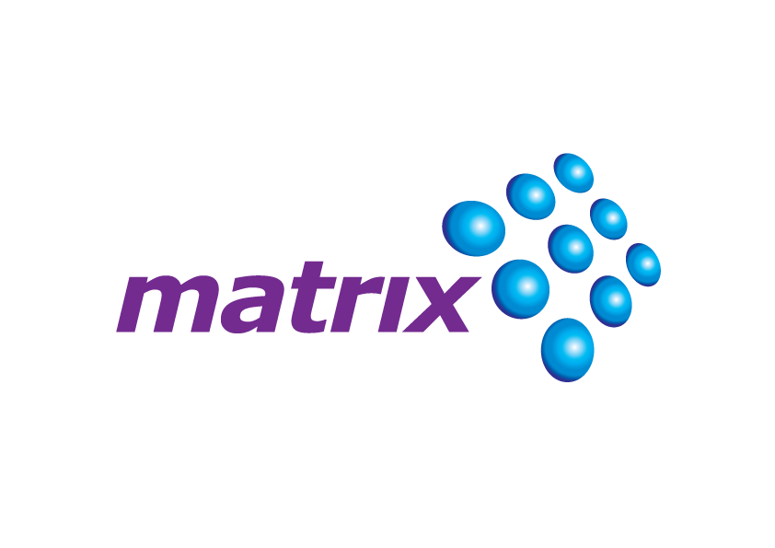






Competitive Landscape
Highly Customized
Private Sector Focus
Public Sector Focus
Off-the-Shelf Product

Slide 6
Competitive Advantage
Cost effective decision making - Implementing cost-effective decision-making strategies empowers municipalities to make informed, data-driven plans, resulting in more efficient resource allocation and substantial cost reductions.
Customization - Tailoring solutions to the unique needs of each municipality is a cornerstone of our approach to customization. By crafting bespoke strategies and services, we ensure that our solutions align precisely with the specific requirements, demographics, and goals of each community.
Expertise - By concentrating our expertise solely on addressing the unique challenges faced by local governments, we deliver a comprehensive and tailored solution that goes beyond generic alternatives.
User friendly platform - Our user-friendly platform is meticulously designed to ensure accessibility for every municipality employee, regardless of their technical background.
Notes:
Competitive Differentiation:
Product Functions and Features: MuniMatrix offers deep data integration and advanced forecasting capabilities, enabling municipalities to proactively prioritize tasks and make informed decisions.
Customization Options: MuniMatrix can tailor solutions to specific urban needs and seamlessly integrate with existing systems, ensuring a customized fit for each client.
Expertise: Our team combines data analytics professionals with municipal government specialists, resulting in deep expertise in tackling urban challenges.
Market Leadership Potential: By focusing on the public sector, MuniMatrix is well-positioned to become a leading player in this specific market.
Strong Brand Recognition: Our established reputation within the municipal sector attracts new clients seeking innovative solutions.
Cost-effective Decision Making: MuniMatrix automates data analysis and generates actionable insights, potentially reducing costs and saving resources for local authorities.
User-friendly Platform: Our intuitive platform and comprehensive training encourage wider adoption, building a strong customer base.
Strategic Partnerships: MuniMatrix collaborates with a diverse network of public and private sector organizations, enhancing our reach and service delivery.

Slide 7
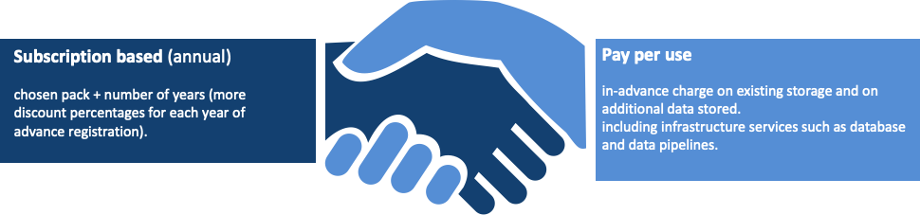
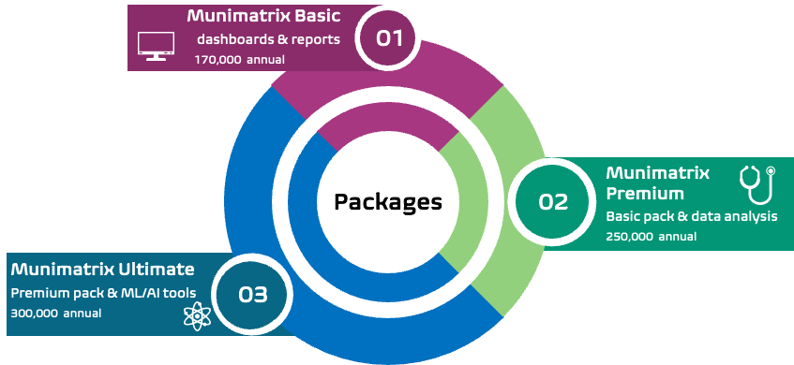
Our Business Strategy

Slide 8






Our Team
Isaac Tsalik
CEO
Ofir Mor
CMO
Shalev Alkaher
CFO
Or Yagol
CTO
Snir Akons
CSO
Elchai Refoua
CPO

Slide 9

Our Need
Analysts & developers salary
130K$ Annual
Founders salary
60K$ Annual
Infrastructures (Cloud, ETL, Databases, GPT4)
14K$ Annual
Microsoft utilities, code editors, GitHub
3K$ Annual
212.5K$ for Pilot with 4 municipalities.
1 Year of development and implementation period.
Workspace & office utilities
5.5K$ Annual

Slide 10


Slide 11

isaac.tzalik@munimatrix.com

